Slide 1





Data Preprocessing and ETL

Slide 2
Agenda
What is Data
Machine Learning
Data Preprocessing
Feature Transformations
Data Cleaning or Cleansing
Work with Missing data
Work with Categorical data
Detect and Handle Outliers
Feature Scaling

Slide 3
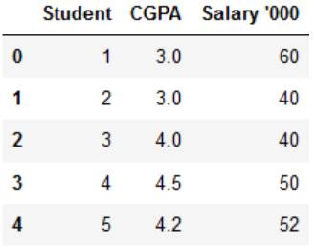



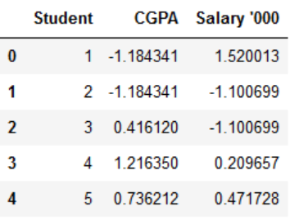
Feature Scaling
It is common to scale data prior to fitting a machine learning model.
This is because data often consists of many different input variables or features (columns) and each may have a different range of values or units of measure, such as feet, miles, kilograms, dollars, etc.
If there are input variables that have very large values relative to the other input variables, these large values can dominate or skew some machine learning algorithms.
The result is that the algorithms pay most of their attention to the large values and ignore the variables with smaller values.
This includes algorithms that use a weighted sum of inputs :
like linear regression
logistic regression
artificial neural networks
as well as algorithms that use distance measures between examples such as :
k-nearest neighbors
support vector machines.

Slide 4
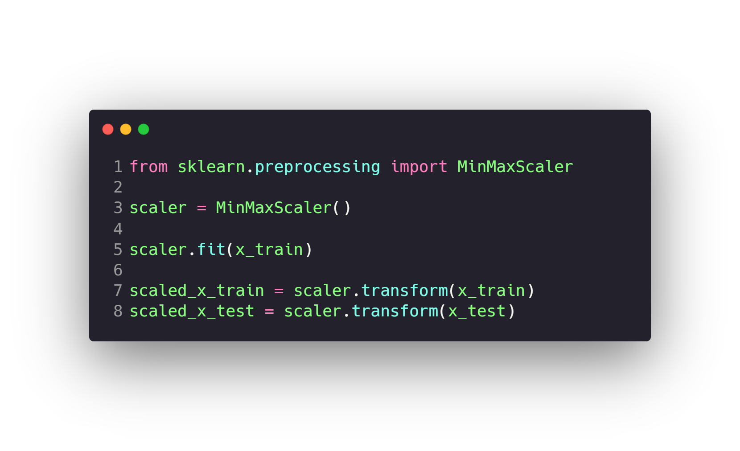
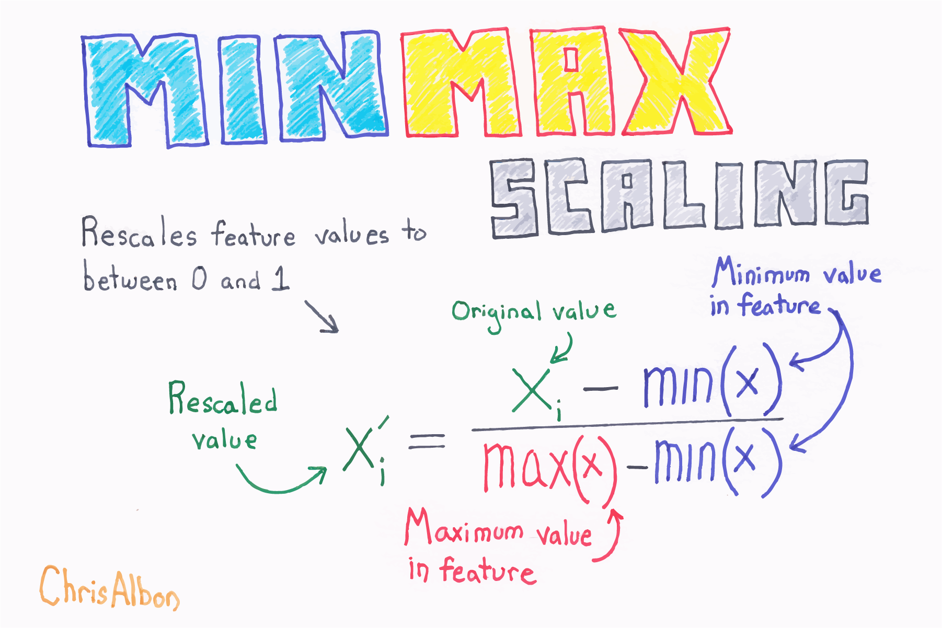
Feature Scaling
Normalization with Sklearn MinMaxScaler.
Standardizing data with StandardScaler.

Slide 5
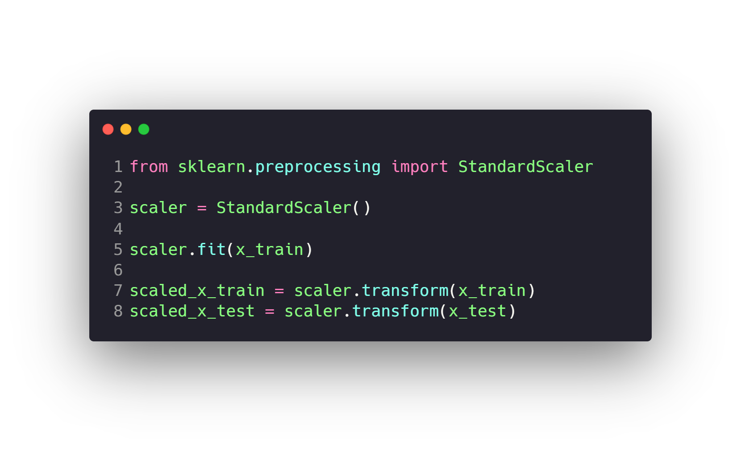
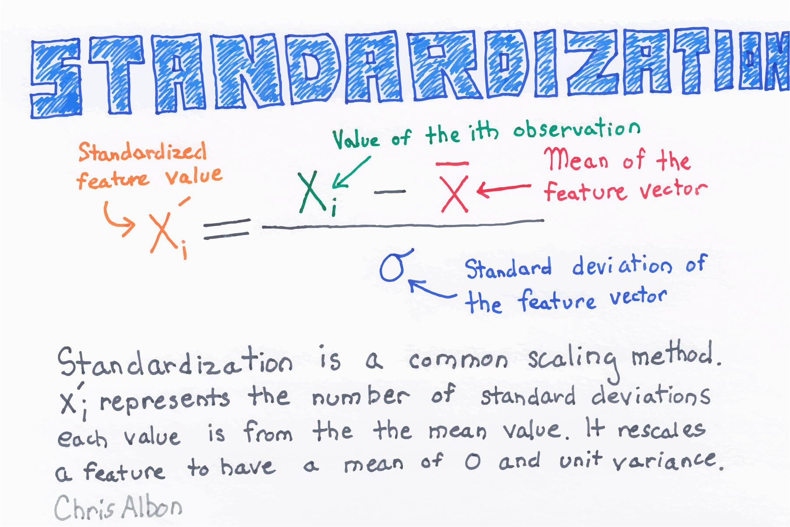
Feature Scaling
Normalization with Sklearn MinMaxScaler.
Standardizing data with StandardScaler.

Slide 6
Normalization with Sklearn MinMaxScaler.
it is the simplest method and consists of rescaling the range of features to scale the range in [0, 1]
Standardizing data with StandardScaler.
Feature standardization makes the values of each feature in the data have zero mean and unit variance.

Slide 7
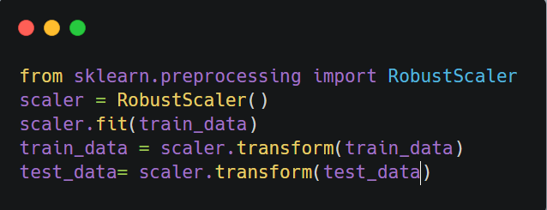
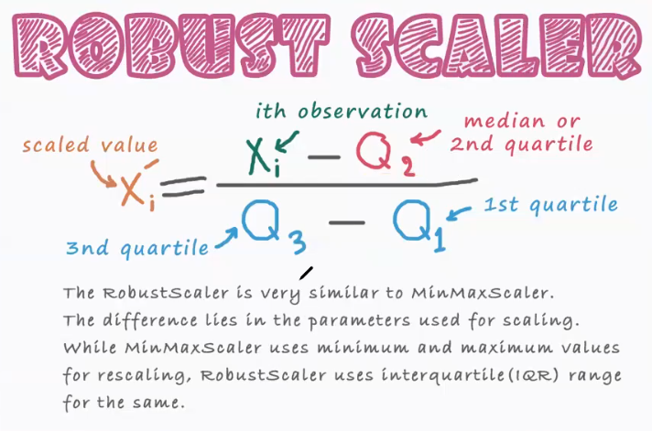
Feature Scaling
Robust_Scaler

Slide 8
What types of preprocessing will be used here??
salary | age | B | class
2400 | 34 | second | 0
2500 | 55 | fourth | 1
2800 | 23 | ninth | 0
7000 | 27 | first | 0
32750 | 43 | third | 0

